Slide 1

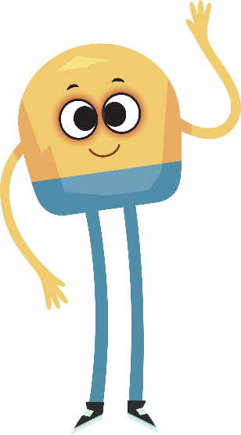

Unit 4: Week 6
Kindergarten

Slide 2
Copyright © Savvas Learning Company LLC. All Rights Reserved.
This publication is protected by copyright, and permission should be obtained from the publisher prior to any prohibited reproduction, storage in a retrieval system, or transmission in any form or by any means, electronic, mechanical, photocopying, recording, or otherwise. For information regarding permissions, request forms, and the appropriate contacts within the Savvas Learning Company Rights Management group, please send your query to:
Savvas Learning Company LLC, 15 East Midland Avenue, Paramus, NJ 07652
or
k12learningpermissions@savvas.com
myView Literacy® is an exclusive trademark of Savvas Learning Company LLC in the U.S. and/or other countries.

Slide 3

Lesson 1

Slide 4
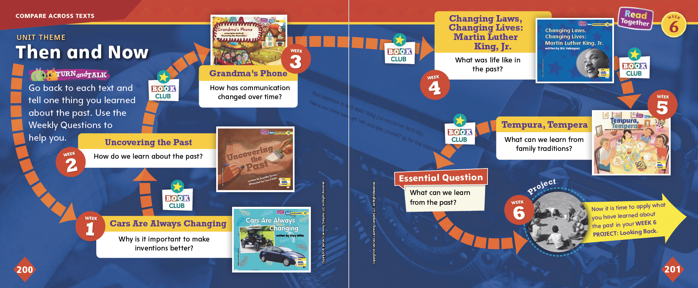
Page
200, 201
Compare Across Texts
Go back to each text and tell one thing you learned about the past.
Notes:
Remind students of the unit theme, Then and Now, and the Essential Question: What can we learn from the past?
Remind students that they have been reading about the past, and they will now try to answer the Essential Question to get ready for their own research projects.
In pairs, have students look back at each text and find sentences or pictures that help them answer the Essential Question.

Slide 5

Page
200, 201
Compare Across Texts
Think about what we can learn from the past.
Write or draw your response.
Notes:
Once again, remind students that all of the selections in this unit are connected by the unit theme, Then and Now. Use the questions below to help students compare themes, topics, and genres across texts.
In Cars Are Always Changing and Grandma’s Phone, we see how some things like cars and phones were different in the past. What is positive and negative about these kinds of changes? (Possible response: The positive thing is that many times the changes improve something. The negative thing is that sometimes changes make more ways a thing can break or not work.)
In Tempura, Tempera, we read about a connection between people from two different places. Why is it important to learn about these connections? (Possible response: People can see how they are alike, and maybe they will understand each other better.)
How do Changing Laws, Changing Lives and Uncovering the Past both help us learn information about the past? (Possible response: Changing Laws, Changing Lives teaches us how one man worked to change unfair laws, and Uncovering the Past gives us information about people from the past.)
Now have students write or draw their responses to the Essential Question: What can we learn from the past?
Then explain to students that this week they will work on a research project in which they will interview an older family member about his or her childhood.

Slide 6


Page
202
Phonological Awareness
Notes:
Tell students that today they will review the sounds /o/ and /ō/. Have students say the sounds with you.
Display the mop Picture Card. This is a picture of a mop. Listen to the middle sound as I say this word: /m/ /o/ /p/. Does the word mop have the middle sound /o/ or /ō/? Students should say the sound /o/.
Display the nose Picture Card. This is a picture of a nose. Listen to the middle sound as I say this word: /n/ /ō/ /z/. Does the word nose have the middle sound /o/ or /ō/? Students should say /ō/
Divide students into two teams, /o/ and /ō/. Tell students that you will say several words with the middle sound /o/ or /ō/. If they hear the sound /o/, the /o/ team will stand up. If they hear the sound /ō/, the /ō/ team will stand up. Use these words: hose, dog, home, hope, flop, top, rope, rot.

Slide 7


Page 202
Phonics
hose
box
Read and write the words on page 202 in your Student Interactive.
Notes:
Hold up the hose Picture Card. Say: This is a picture of a hose. The beginning sound in hose is /h/. The beginning sound /h/ is spelled with the letter h.
Write hose on the board and underline the letter h. Point to the letter. What letter spells the sound /h/ at the beginning of home? Students should say the letter h.
Hold up the box Picture Card. Say: This is a picture of a box. The ending sound in box is /ks/. The ending sound /ks/ is spelled with the letter x.
Write box on the board. Underline the letter x. What letter spells the sound /ks/ at the end of box? Students should say the letter x.
Have students turn to p. 202 in the Student Interactive. Ask them to look at the first picture. Then tell students to look at the sentence. Say: There is a letter missing that will complete the sentence. Let’s read the beginning part of the sentence: She had a _at. I see the picture is a hat. Let’s write hat on the line.
Have students finish p. 202 with a partner.

Slide 8
High-Frequency Words
this
round
may
Notes:
Write the high-frequency words this, round, and may.
Show students familiar letter sounds, such as s/s/ and m/m/, in these words.
Point to the word this and read it.
Have students identify the word this by pointing to it, and then have them read it.
Repeat for each word.

Slide 9
Spelling
I tug on the rope.
Where is the sun?
This water is cold.
That bird is eating a nut.
He may go to the park.
I see a bug.
Notes:
(Note: Move the orange boxes to cover each bold spelling word before you read aloud the words and sentences.)
Read aloud the words and sentences. Have students spell the words with the sound /kw/, the other spelling words, and the two high-frequency words.
I tug on the rope.
Where is the sun?
This water is cold.
That bird is eating a nut.
He may go to the park.
I see a bug.
Reveal the spelling word and have students check their work.

Slide 10
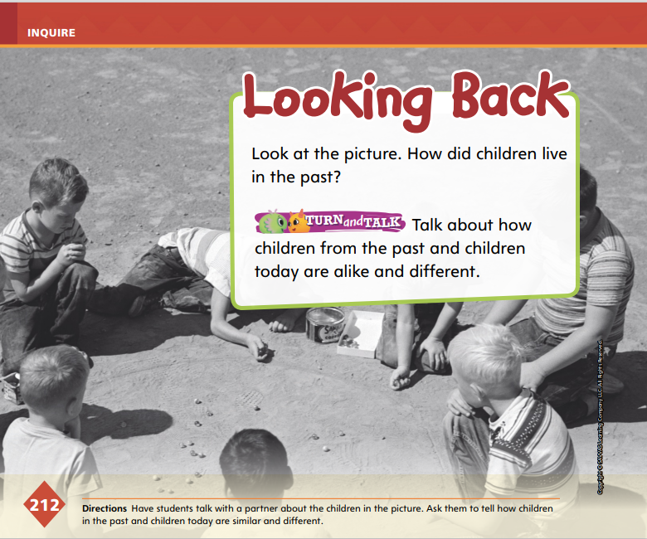

Page
212
Inquire – Introduce the Project
Look at the picture.
How did children live in the past?
Talk about how children from the past and children today are alike and different.
Notes:
Explain to students that this week they will work on a research project in which they interview an older family member about his or her life as a child. Remind students that doing research on something means learning information about it so that you can understand it.
Explain to students that they will work collaboratively with others through discussion to develop and follow a research plan—a plan for how and where to search for the information they need. Tell them that they will follow rules during these discussions, including taking turns. Use the Model and Practice below to help students begin thinking about and planning their research projects.
Say: First, let’s think about what was different for children in the past. Start by thinking about the things you do for fun, places you go, and what helps you do your daily routines.
Use the questions below to help students begin looking back.
What kinds of things do children do differently today than in the past?
What do we have now that people in the past did not?
How are children the same now as in the past?
Have student pairs look at the picture on p. 212 in the Student Interactive. Have students use the picture to talk about the above questions and the question on p. 212, How did children live in the past?

Slide 11
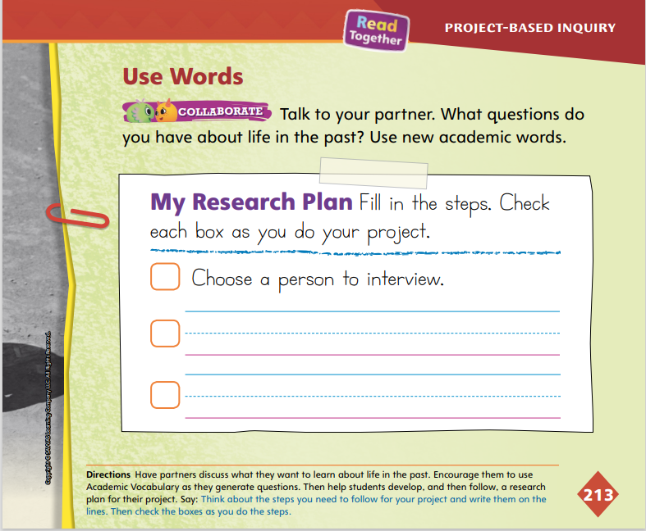

Page
213
Inquire – Academic Vocabulary
Turn to page 213 in your Student Interactive.
Talk about the questions you have about the past using your Academic Vocabulary.
Notes:
Remind students that the Academic Vocabulary words time, change, discover, and tradition all relate to the unit theme, Then and Now.
Model these words by using them in sentences related to a research plan. Say: I want to discover more about my family member. I want to know about changes between then and now. I would like to know about a different time. I would like to learn about another family tradition.
Assist students as they collaborate on developing their research plans on p. 213 in the Student Interactive. Tell them to follow discussion rules, such as taking turns.
For differentiated support:
If students struggle to talk about and create research plans, provide sentence frames, such as When I interview, I will ______________. I will need to __________ to remember the answers of my interviewee.
Invite students to write or draw what they already know about the family member they plan to interview. Have them share their ideas with a partner and use academic vocabulary as they tell about their writing or drawing.

Slide 12
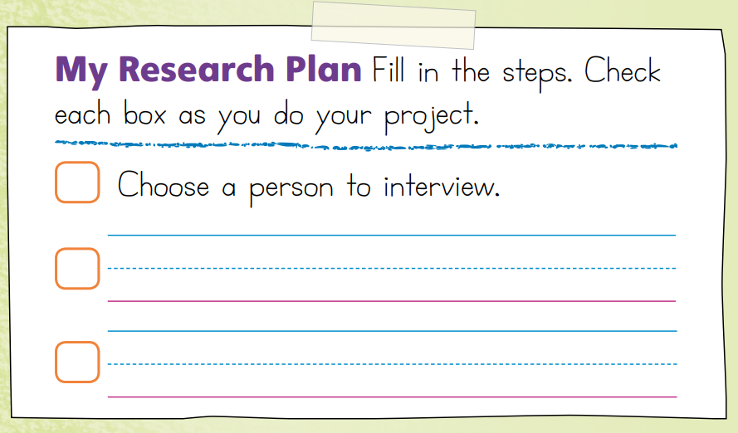
Page
213
Inquire – Develop a Research Plan
With a partner, think of a research plan.
Check off the steps as you complete them.
Notes:
Tell students that they will begin their projects.
Once they have thought of a research plan, explain that the next step is to learn more about informational texts and questions for the interview.
Tell students they should follow the research plan they developed and check off the steps as they complete them.

Slide 13
Lesson 2

Slide 14

Page 203
Phonics
tub
mule
tube
tune
cub
tug
cube
rug
Notes:
Today we are going to review short and long u. Hold up the tub Picture Card. This is a picture of a tub. Listen to the sounds in the word: /t/ /u/ /b/. What sound do you hear in the middle of tub? Yes, it is the sound /u/. Write the word tub on the board. Which letter spells the sound /u/? Students should say the letter u.
Write the word tube below tub. This is the word tube. Listen as I say the sounds in the word: /t/ /ū/ /b/. What sound do you hear in the middle of tube? Yes, it is the sound /ū/. Which pattern spells the sound /ū/? Students should identify the u_e pattern.
Write the word cub on the board. Listen carefully to the following word: /k/ /u/ /b/, cub. Do you hear the sound /u/ in this word? What would the word be if we added an e to the end?
Write the word cube on the board, and have students read the word. Write the following words on the board: mule, tune, tug, rug. Read the words with students. Have students hold up one finger if they hear the sound /u/. Have them wave their hands if they hear the sound /ū/.

Slide 15
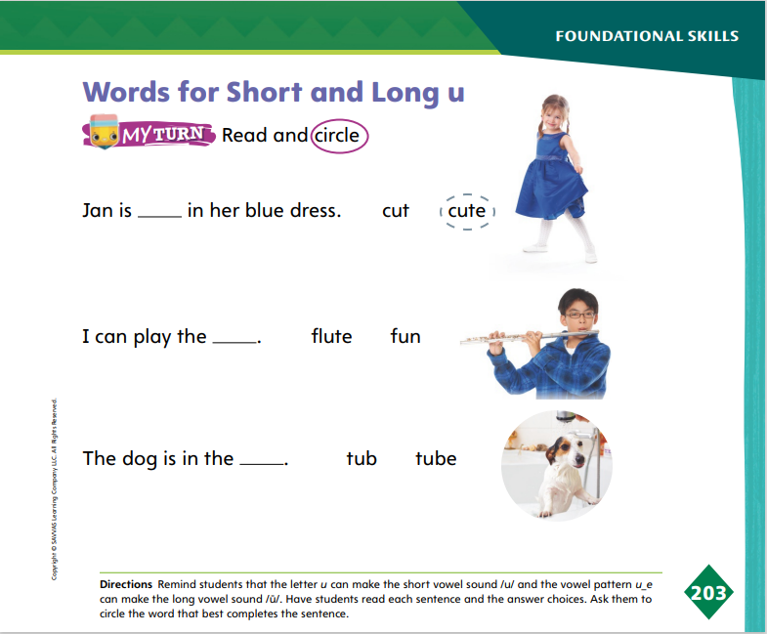
Page 203
Apply
Turn to page 203 in your Student Interactive.
Circle the words that best complete the sentence.
Notes:
Have students complete p. 203 in the Student Interactive.

Slide 16
High-Frequency Words
this
round
may
Notes:
Tell students that high frequency words are words that they will hear and see over and over in texts.
Write and then read the words this, round, and may.
Have students read the words with you.
Have students clap for each letter as they spell the words.

Slide 17
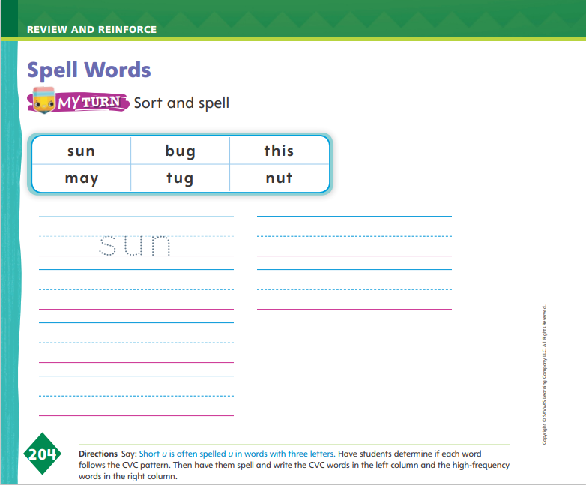
Page 204
Spelling
bug
nut
Turn to page 204 in your Student Interactive and complete the activity.
Notes:
Explain that CVC words begin and end with a consonant and have a vowel in the middle. The vowel spells a short vowel sound.
Write the words bug and nut on the board. Underline the consonants and circle the vowels. Then say each word aloud and point out the CVC pattern.
Have students complete p. 204 in the Student Interactive. Tell students to use the CVC pattern and what they know about high-frequency words they have learned to help them.

Slide 18
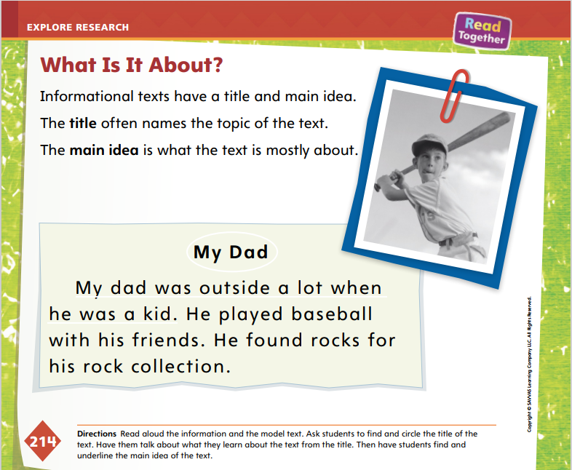
Page 214
Explore and Plan – Informational Text
Turn to page 214 in your Student Interactive.
Notes:
Explain that informational texts have a title and main idea. Direct students to p. 214 in the Student Interactive. Use the Model and Practice below to help students explore the characteristics of informational writing.
Say: Writers can tell a lot of information with the titles they choose. The title tells what a text is about because it gives it a name. How can we tell that something is a title? Allow volunteers to give responses. (Possible responses: A title comes at the top of a text. A title is on the cover if the text is a book.)
Tell students: Informational writing, like what you will do about your family member, has a main idea. The main idea tells what the text is mostly about. Think about the main idea in the student model on page 214.
Read the student model aloud, and then guide students to complete the activity on p. 214.
Guide students to understand the parts of an informational text as they work on the activity on p. 214. Point to parts of informational writing in the student model, and discuss how these parts help us learn something about the topic. In this case, the topic is the writer’s dad. Encourage students to think about questions they can ask in their research and how that could be made into informational writing.

Slide 19

Apply
Think of questions you will ask the person you are going to interview about their childhood.
Who will be your audience for your informational text?
Notes:
Remind students that they will conduct an interview for their research projects. Tell students that they will ask questions of the person they interview about that person’s childhood.
Have students consider the audience for their informational text.
Ask questions to help students think about audience, such as: What would your audience like to know about the person you interview? What could your audience learn about the past?
Record students’ responses. Remind students to continue to think about their audience as they write their informational texts.

Slide 20

Page 215
Conduct Research
Introduce yourself.
Ask a question.
Listen and take notes.
Shake hands and say thank you at the end of the interview.
Notes:
Explain to students that they will be conducting interviews for their research. Tell them that an important part of conducting an interview is generating, or making up, questions to ask the person you are interviewing.
Have students discuss the picture on p. 215 in the Student Interactive. Use the Model and Practice to explain how to express needs and wants.
Say: To conduct an interview means to ask someone questions. In this case you will be asking your family member about his or her childhood. So you need information from the person; however, you want to ask in a nice way. How do you think we should start our interviews? Allow volunteers to share their ideas. Answers will vary, but focus first on a start or introduction.
Say: Now we are going to practice our interviews. You will work with a partner and take turns introducing yourself, asking questions, listening to the answers, and thanking the person at the end of the interview. Explain that when they have their real interviews, students will take notes, and they will work on this skill in the next lesson.
Write the steps on the board:
Introduce yourself.
Ask a question.
Listen and take notes.
Shake hands and say thank you at the end of the interview.

Slide 21
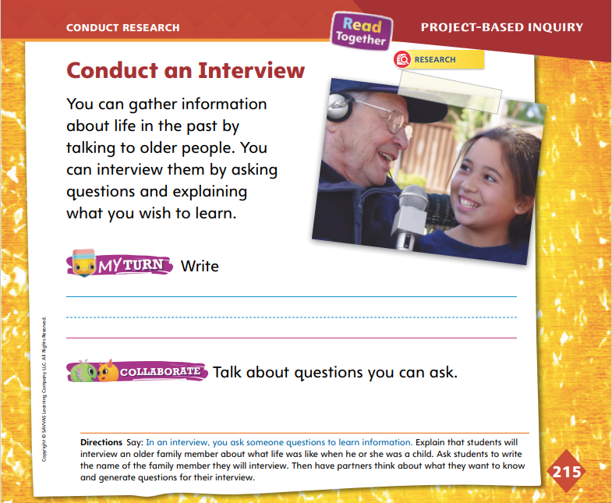
Page 215
Conduct Research
Turn to page 215 in your Student Interactive.
Write questions for your interview.
Notes:
Have students write the name of the person they will interview on p. 215.
Have students collaborate with their project partners to generate questions for inquiry while conducting an interview.
For differentiated support:
Support students by providing a sentence frame for their interview questions: What did you play when you were a child? I like to play _____. Also, have them draw out their ideas for questions.
Students who easily generate inquiry questions can write their questions on a sheet of paper and underline key words to help them focus on their interview and make connections between the past and present.
When students have practiced the interview process and generated interview questions, have them return to the research plan they created and check the boxes “Choose a person to interview” and “Ask questions,” or whatever point is similar in their plans. Explain to students that the next step is to learn to take notes about their interviews.

Slide 22
Lesson 3

Slide 23
Phonological Awareness
rug
dust
June
tune
flute
cube
lunch
jump
Notes:
Tell students that today they will review the sounds /u/ and /ū/. Have students repeat the sounds /u/ and /ū/ after you.
Say the word rug. Listen to the middle sound as I say this word: /r/ /u/ /g/. Does the word rug have the middle sound /u/ or /ū/? Students should say the sound /u/.
Say the word June. Listen to the middle sound as I say this word: /j/ /ū/ /n/. Does the word June have the middle sound /u/ or /ū/? Students should say /ū/.
Divide students into two teams, /u/ and /ū/. Tell them that you will say several words with the middle sound /u/ or /ū/. If they hear the sound /u/, the /u/ team will stand up. If they hear the sound /ū/,the /ū/ team will stand up. Use these words: flute, lunch, dust, tune, cube, jump.

Slide 24



Phonics
u_e
rub
ham
tune
mix
Notes:
Use the Uu, Hh, and Xx Alphabet Cards to review the sound spellings for short u, Hh, and Xx. Write the vowel pattern u_e on the board to review the sound spelling for long u.
Write the word rub on the board. You have learned all the letter sounds in this word. Let’s use what we know about the letters and sounds to read the word together.
Point to each letter as students say the sound. What sound does r spell? What sound does u spell? What sound does b spell? Now let’s blend the sounds together to read the word: /r/ /u/ /b/, rub.
Continue the routine with these words: ham, tune, mix.
Have students take turns reading the words on the board with a partner.

Slide 25
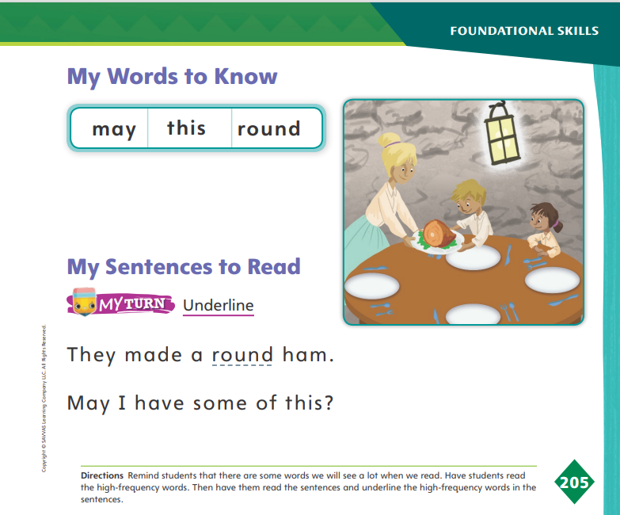
Page 205
High-Frequency Words
may
Turn to page 205 in your Student Interactive.
this
round
Notes:
Say: Today we will practice reading the high-frequency words may, this, and round. Have students read the words at the top of p. 205 in the Student Interactive with you: may, this, round.
Have students look at the words at the top of p. 205. Say: I will read a word, and I want you to point to it. Then we will read the word together. Read may, and have students point to it. Now let’s read the word together: may. Repeat with the other words. Ask students to use the words in sentences.
Have students read the sentences on p. 205 with you. Ask them to identify the words may, this, and round in the sentences. Have them underline the high-frequency words in the sentences. Then have them read the sentences with a partner.

Slide 26
Spelling
sun
bug
tug
nut
Notes:
Remind students how to identify words with the CVC pattern.
Have students practice spelling CVC words as you sound out each word. Use the following words: sun, bug, tug, nut. Make sure to say each phoneme clearly (/s/ /u/ /n/, sun)..
Have students complete Spelling p.215from the Resource Download Center. Clik path: Table of Contents -> Resource Download Center -> Spelling -> U4W6

Slide 27
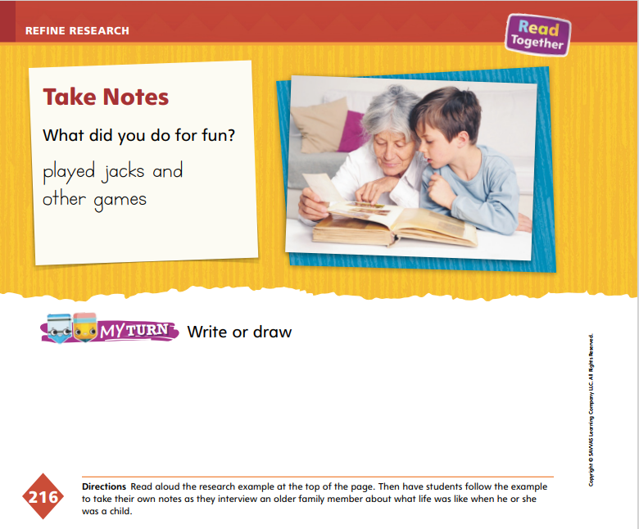
Page 216
Collaborate and Discuss
Turn to page 216 in your Student Interactive.
Notes:
Taking notes will help students remember information about their interviewee. Explain to students that they can organize their notes in a Question and Answer graphic organizer.
Write the letter “Q” on the board. Leave some space below it and then write the letter “A.” Say: I can keep my interview information organized by having my questions ready after each letter “Q,” and then I will leave a space for the answer after the letter “A.”
Point to “Q.” Write or draw your first interview question. Skip three lines or more and write an “A,” and skip another three lines or more. Do this pattern until you have all of your questions ready to take notes during your interview. Assist students as they prepare for note-taking.
Direct students to p. 216 in the Student Interactive. Read aloud the research example at the top of the page. Say: This picture shows a student looking through pictures with his interviewee. I read his question, What did you do for fun? His notes are below the question. You may also draw your notes to remember the answer to the question.

Slide 28
Page 216
Refine Research
Turn to page 216 in your Student Interactive and complete the activity.
Write or draw details you learned from the interview.
Notes:
Once students have completed their interviews, they may draw or write details they learned from the interview on p. 216.
Encourage them to use as much detail as they remember.
Have students think about what they can do to make their writing or drawing better. Remind students that their projects are informational texts that teach the audience about the people they interviewed.

Slide 29
Lesson 4

Slide 30
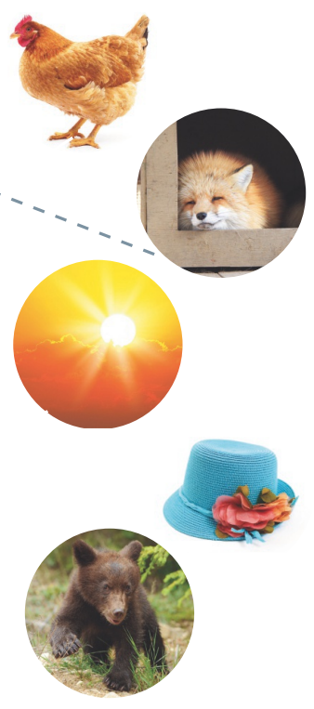
Page 206
Phonics
cub
Turn to page 206 in your Student Interactive.
cube
hut
mix
Notes:
Write the word cub on the board. This is the word cub. Listen as I blend the sounds to read the word: /k/ /u/ /b/, cub. Have students come up to the board and blend the sounds in cub as they point to the letters. Circle the u in cub as you say /u/. Write the word cube on the board under cub.
Ask: Do you remember what happens to the vowel sound when an e is added to the end of a word? Students should say the middle sound changes. What is the new middle sound? Who can read the new word on the board? Have volunteers come to the board and read the word cube. Circle the letters u and e in the word.
Write the word hut on the board. This is the word hut. Listen as I blend the sounds to read the word: /h/ /u/ /t/, hut. Have students come up to the board and read the word hut. Which letter spells the sound /h/ in hut? Yes, the letter h spells the sound /h/ in hut. Circle the h in hut as you say /h/. Continue with the word mix to review the sound /ks/ spelled x.
Have students turn to p. 206 in the Student Interactive, and name the pictures with students. Then have them point to the first phrase. Let’s read this phrase together: a fox in a box. Which picture shows a fox in a box? Have students draw a line from the phrase a fox in a box to the picture of the fox.

Slide 31
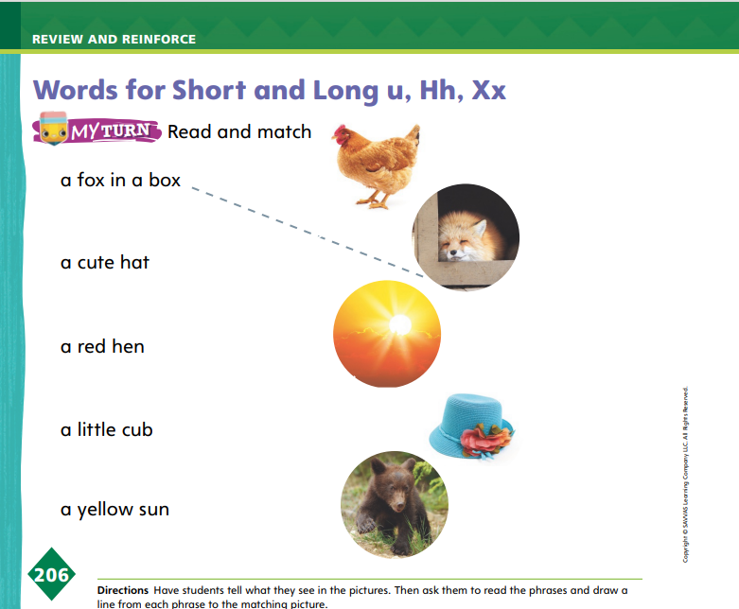
Page 206
Apply
Turn to page 206 in your Student Interactive and complete the activities.
Notes:
Have students complete p. 206 in the Student Interactive.

Slide 32
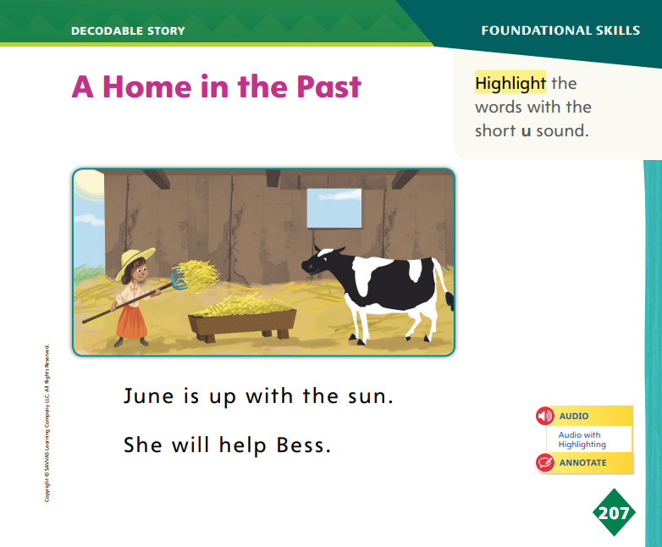
Page 207
Decodable Story
Turn to page 207 in your Student Interactive. Read “A Home in the Past” with your partner.
Notes:
Have students turn to p. 207 in the Student Interactive. We are going to read a story today about a family from long ago.
Point to the title of the story. The title of the story is A Home in the Past. I hear the sound /h/ in the word Home. In this story, we will read other words with the sound /h/ and other sounds we have learned, such as /u/, /ū/, and /ks/.
Remind students of this week’s high-frequency words: this, round, may. Tell them that they will practice reading these words in the story A Home in the Past. Display the words. Have students read them with you. When you see these words in the story A Home in the Past, you will know how to identify and read them.
Have students whisper-read the story as you listen in. Then have students reread the story page by page with a partner. Listen carefully as they use letter-sound relationships to decode. Partners should reread the story with the other student beginning.
After students have read the story, call their attention to the title. I see the letter H in the word Home. What sound does the letter H spell? Help them identify, or say, the sound /h/.
Then have students read the first two sentences in the story on p. 207 in the Student Interactive. I see the letter u in three of the words in the first sentence. Read the words June, up, and sun. Which two words have the sound /u/ spelled u? Have students highlight the words with the sound /u/: up, sun.

Slide 33
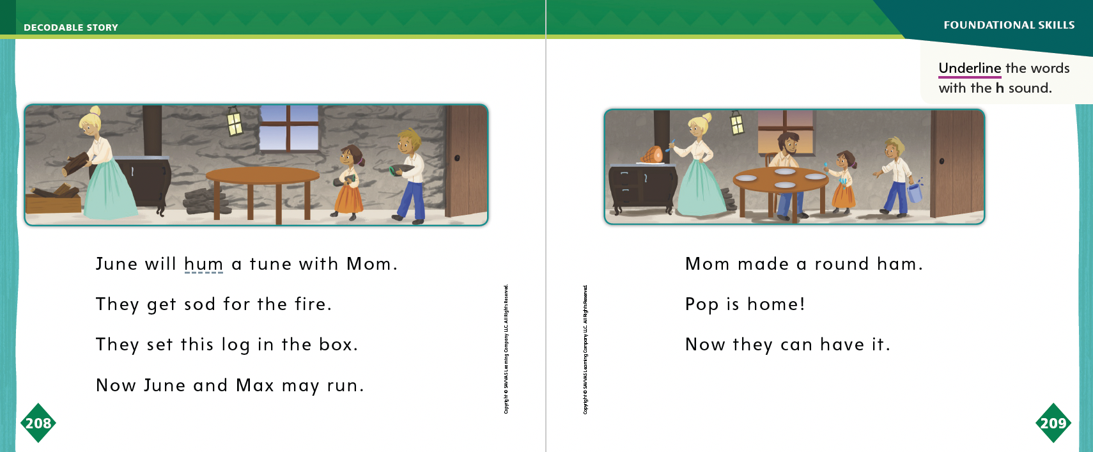
Page 208, 209
Decodable Story
Turn to pages 208-209 in your Student Interactive. Read “A Home in the Past” with your partner.
Notes:
Have students turn to pp. 208–209. I hear a word on page 208 that begins with the sound /h/. Which word begins with /h/? Students should supply the word hum. Which words on page 209 begin with the sound /h/? Students should supply the words ham, home, and have.
Have students underline the words that begin with the sound /h/.

Slide 34
Spelling
bed
fed
den
vet
Work with your partner to practice spelling CVC word.
Notes:
Have students recall the previously learned CVC words with short e: bed, fed, den, vet.
Say the words bed, fed, den, and vet one at a time. Have students spell the words aloud together. Write the words on the board as students spell them.
Have students work in pairs to practice spelling CVC words. Create your own list of words for students based on class strengths and weaknesses

Slide 35
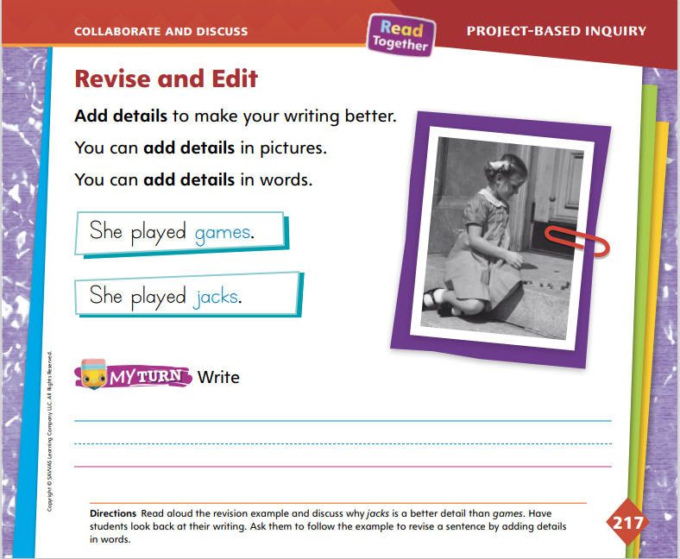
Page 217
Collaborate and Discuss
Turn to page 217 in your Student Interactive and complete the activity with a partner.
Notes:
Tell students that when they revise and edit, they add details to make the writing better. Use the Model and Practice to guide students in revising their work.
Direct students’ attention to p. 217 in the Student Interactive. Have them look at the picture while you read the sentences. Say: In the first sentence, the writer uses the word games. In the revised, or changed, sentence, the writer uses jacks instead of games. Why is the second sentence better?
Ask student volunteers to share their thoughts, and then follow up by saying, Jacks tells us exactly what game she played. That detail helps us imagine and understand how this person spent her time. The detail makes the writing better. I want you to add details to your writing to make it better.
Ask questions to help students revise their informational text.
Which words can I change to add a special detail?
How can I add a detail to help my audience better understand the person I interviewed?
Is the detail interesting enough to help my audience understand my interviewee?
Have students work on the My Turn activity on p. 217. Tell students to support their informational writing by adding details. Remind them to consider the audience, their classmates. Have students create a neat copy on a separate sheet of paper.

Slide 36
Apply
Edit your informational text by adding details.
Write a clean, edited, neat copy of your informational text on a separate sheet of paper.
Notes:
Have students work on the My Turn activity on p. 217. Tell students to support their informational writing by adding details. Remind them to consider the audience, their classmates.
Have students create a neat copy on a separate sheet of paper.
Meet with students to discuss their drawings and writing. Guide them in adding more specific words to their writing or drawings. Remind them that they will need to have a finished product to present to the class the next day.
For differentiated support:
Intervention If students struggle revising their work, provide prompts to help them get more specific in their writing. Ask: What special thing did your interviewee do for fun? What special place did your interviewee go? Record students’ responses. Then have students add these details to their writing.
If students easily revise and edit their writing, have them review their notes from the interview and add another drawing or detail to their writing. Allow students to add more color and detail to their drawings.
Have students return to their research plans and check off any step related to revising and editing. Remind them that they will share their informational writing and drawing with the class.

Slide 37
Lesson 5

Slide 38
Phonological Awareness
red
read
fed
feed
bead
bed
bet
beat
Notes:
Tell students that today they will review the sounds /e/ and /ē/. Have students repeat the sounds /e/ and /ē/ after you.
Say the word red. Listen to the middle sound as I say the word red: /r/ /e/ /d/. Does the word red have the middle sound /e/ or /ē/? Students should say the sound /e/.
Say the word read. Listen to the middle sound as I say the word read: /r/ /ē/ /d/. Does the word read have the middle sound /e/ or /ē/? Students should say /ē/.
Divide students into two teams, /e/ and /ē/. Tell them that you will say several words with the middle sounds /e/ and /ē/. If they hear the sound /e/, the /e/ team will stand up. If they hear the sound /ē/, the /ē/ team will stand up. Use these words: fed, feed, bead, bed, bet, beat.

Slide 39
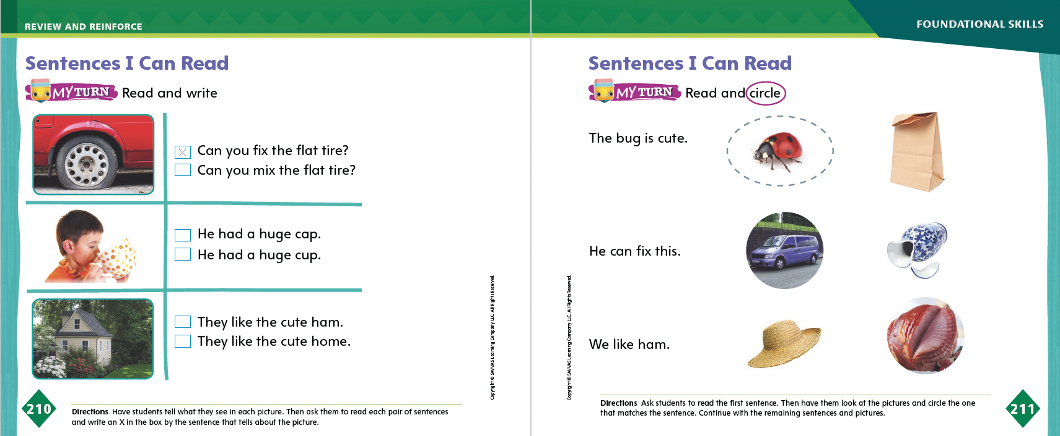
Page 210, 211
Phonics
Turn to pages 210-211 in your Student Interactive and complete the activities.
Notes:
Tell students that today they will read some sentences. The sentences we read will include only sounds and high-frequency words we already have learned.
Give a child a pencil that needs to be sharpened. Write on the board: [Student’s name] can fix this. [Student’s name] can mix this. Let’s read the sentences.
Read the sentences with students. What is [Student’s name] holding? What is the matter with the pencil? Students should say it does not have a point. Which sentence on the board best matches [Student’s name] and the pencil? Students should say [Student’s name] can fix this.
Guide students as they use letter-sound relationships to read the words and complete the activity on p. 210 in the Student Interactive. Then have them work with a partner to complete p. 211.

Slide 40
High-Frequency Words
this
round
may
Notes:
Remind students that high frequency words are words that appear over and over in texts.
Say the word this and ask students which letters spell the word.
Have students
say the letters as you write them on the board.
repeat with round and may.
read the words aloud.

Slide 41
Spelling
I saw a small, black bug.
There is a nut on that plant.
May I help you with that?
She gave his sleeve a tug.
This is my bedroom.
The sun looks big today.
Notes:
(Note: Move the orange boxes to cover each bold spelling word before you read aloud the words and sentences.)
Read aloud the words and sentences. Have students spell the words with the sound /kw/, the other spelling words, and the two high-frequency words.
I saw a small, black bug.
There is a nut on that plant.
May I help you with that?
She gave his sleeve a tug.
This is my bedroom.
The sun looks big today.
Reveal the spelling word and have students check their work.

Slide 42
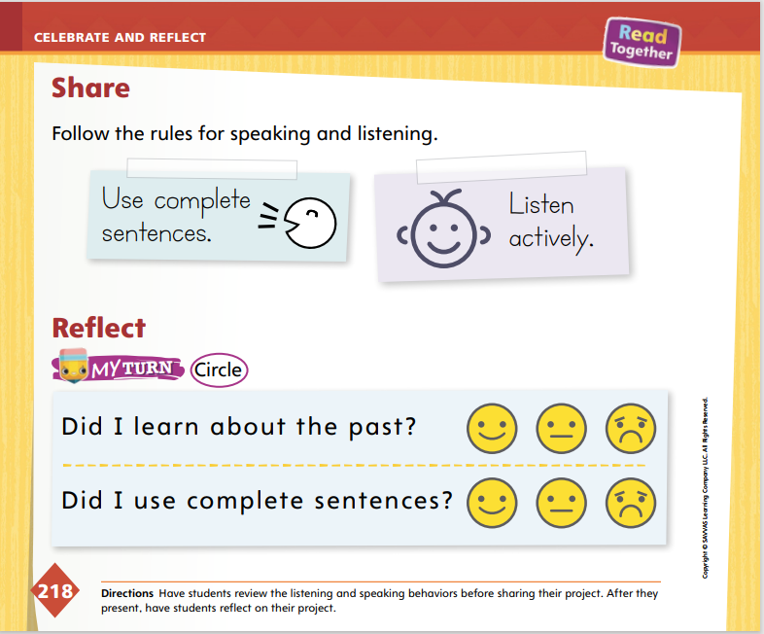
Page 218
Celebrate and Reflect
Turn to page 218 in your Student Interactive.
Share your research project with your classmates as you follow the rules for speaking and listening.
Notes:
Tell students that they will share their research projects about their family members with the class.
Give students time to practice their presentations with their partners. Tell students to speak audibly and clearly and use complete sentences as they share information and ideas.
Remind them to practice showing their writing or drawings and photographs (if they have them) as they speak. Use the Active Listening Routine to help students be good listeners.
Model the active listening routine to set expectations for audience members.
Look: Look at the person who is talking. Do not talk.
Think: Think about what the person is saying.
Respond: Raise your hand when you have a question. Clap when the speaker is finished.

Slide 43
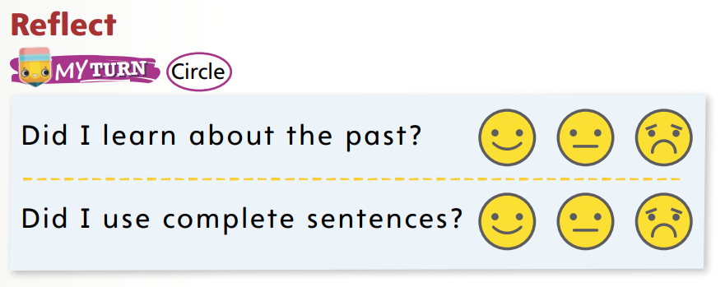
Page 218
Celebrate and Reflect
Turn to page 218 in your Student Interactive and complete the activity.
Notes:
Allow time for students to reflect on the project. Remind students of the unit theme, Then and Now. Use the theme as a starting point for their reflection to discuss how the past is different or the same as the present.
Ask questions, such as What did you learn about the family member you interviewed? What did you learn about how to do an interview? What did you learn about your own likes and dislikes as you researched and wrote?
Guide students to complete the activity at the bottom of p. 218 in the Student Interactive. Give some examples of complete sentences so that students can reflect and answer the second question.

Slide 44
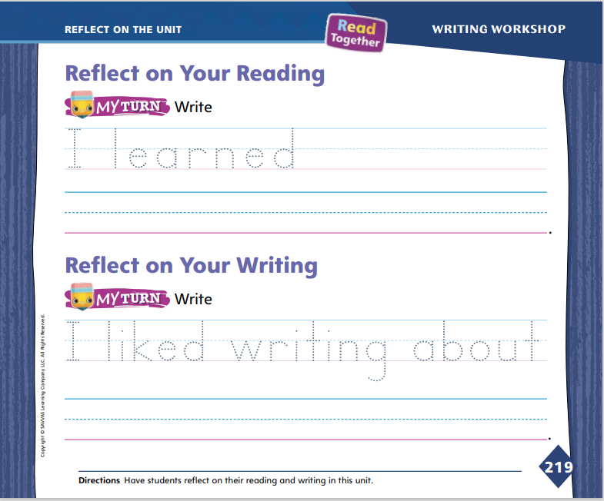
Page 219
Reflect on the Unit
Turn to page 219 in your Student Interactive and complete the activities.
Notes:
With students, review the Unit Goals page at the beginning of the unit. Have students reflect on their reading and writing skills. Review and discuss the Essential Question: What can we learn from the past?
Display the unit table of contents. Ask volunteers to briefly tell the main points of each reading selection. Have students point to the display of the text as they speak. Ask other volunteers to offer thoughts about the selection, such as: I learned about the past in this text because ______. This text helped me to see how then and now are the same because ________.
Have volunteers tell what they learned about writing. Ask students to talk about their favorite writing. Use prompts, such as: What did you enjoy the most about writing during the project? What kind of writing would you like to do again?
Direct students to trace the dotted letters under each Reflect activity on p. 219 in the Student Interactive. Help them record their responses on the lines.

Slide 45
Unit 4: Week 6
Kindergarten

